Slide 1

CloudAid – A Cloud-Native Disaster Response and Assistance Management System
CNAD Project Review-1
 | Under the Guidance of Ms. K. Bhavya Varma Assistant Professor Department of CSE, KLH Bowrampet Campus
Team Members M.SUCHITA-2420090122 GNANESHWAR -2420030659 CH IKSHWAK-2420030036

Slide 2
Outline of Project Work
Focus
Introduction
Literature Survey
Challenges
Research Objectives
Conclusion & Future Work
References

Slide 3
Introduction
Disasters such as floods, cyclones, earthquakes, and fires require quick communication and effective coordination among citizens, volunteers, administrators, and emergency responders.
Traditional approaches to disaster management may involve scattered information and manual coordination, making it difficult to manage emergency requests and allocate resources efficiently.
CloudAid is a cloud-native disaster response and assistance management system that provides a centralized platform for emergency reporting, resource management, volunteer coordination, shelter management, and notifications.
The system uses a microservices architecture and container technologies to support modular development, flexible deployment, and scalability.

Slide 4
Problem Statement
During disasters, emergency information and assistance requirements can arise from multiple locations simultaneously. Managing these requests without a centralized platform can make coordination between citizens, volunteers, administrators, and responders difficult.
Disaster response also requires efficient tracking of available resources, shelter capacity, volunteer availability, and emergency updates.
CloudAid addresses these challenges by proposing a centralized, cloud-native platform that organizes disaster-related information and assistance activities through independent services.

Slide 5
Objectives
The primary objectives of CloudAid are:
To develop a centralized platform for disaster reporting and assistance management.
To enable citizens to report emergencies and request assistance.
To improve the management and distribution of emergency resources.
To coordinate volunteers and responders according to emergency requirements.
To manage shelter information and availability.
To provide notifications and critical updates to relevant users.
To adopt microservices for modular and independent service deployment.
To use Docker and Kubernetes to support containerization, orchestration, scalability, and reliability.

Slide 6
Literature Survey
Authors | Title of the Paper | Methodology | Inferences | Limitation/Future work
Mansura Habiba & Shamim Akhter [1] 2025 | A Cloud Based Natural Disaster Management System, GPC 2013, LNCS 7861, Springer | Proposed a cloud-based workflow management system using Cloud computing, Web Services, Amazon EC2, Workflow Engine, Workflow Scheduler, Workflow Monitor, Role Manager, Web Portal, and Notification. The system distributes tasks among different services to improve disaster-response efficiency. | Cloud computing provides scalability, flexibility, reliability, flexible information access, data backup, resource sharing, and faster decision-making during disasters. The system can handle large amounts of disaster-related data and dynamically provide computing resources when demand increases. | The paper mainly focuses on a workflow-based cloud DMS. It does not discuss modern microservices, Docker, or Kubernetes-based orchestration, which can be explored in future systems for independent service deployment and scaling.
Luís Pedro Pina Ferreira [2] 2023 | Smart Orchestration on Cloud-Native Environments (2024) | Cloud-native orchestration can simplify deployment and management, reduce human intervention, and improve the efficiency and performance of distributed applications. Kubernetes helps manage complex cloud-native environments. | Cloud-native orchestration can simplify deployment and management, reduce human intervention, and improve the efficiency and performance of distributed applications. Kubernetes helps manage complex cloud-native environments. | The work mainly focuses on multi-domain cloud-native orchestration and infrastructure management, rather than disaster-response applications. CloudAid applies these cloud-native concepts to disaster management and assistance coordination.
Dongxin Bai, Jingtian Tang, Guangyin Lu, Ziqiang Zhu, Taoying Liu & Ji Fang [2] 2018 | The Design and Application of Landslide Monitoring and Early Warning System Based on Microservice Architecture | Developed a microservice-based monitoring and early-warning system. Functions such as data reception, data analysis, user management, project management, early warning and prediction were divided into independent microservices. Used distributed databases, RabbitMQ, Redis, Consul and Nginx load balancing. | Microservices decouple system components, distribute computing and service loads, improve scalability, fault tolerance and stability, and support real-time processing of large amounts of sensor data. The system successfully handled thousands of sensors and millions of data records. | Future work focuses on combining monitoring big data with geological big data and improving early identification and emergency-response technology for potential landslide risks.

Slide 7
Proposed System
CloudAid integrates the major activities involved in disaster response into a single platform.
Citizens can submit emergency reports, while administrators can manage incoming requests and coordinate assistance. Dedicated modules handle resource availability, volunteer coordination, shelter information, and notifications.
The application follows a microservices architecture in which individual services communicate through REST APIs. React.js provides the frontend, Spring Boot supports backend development, and PostgreSQL stores application data.
Docker packages application components into containers, while Kubernetes manages container deployment and orchestration.

Slide 8
Modules of CloudAid
1. User Management: Supports the organization of users and their roles within the platform.
2. Emergency Reporting: Allows citizens to submit information about disasters and request assistance.
3. Resource Management: Organizes information about emergency supplies and resource availability.
4. Volunteer Coordination: Helps coordinate volunteers according to assistance requirements.
5. Shelter Management: Maintains information about shelters and their availability.
6. Notification System: Provides a mechanism for communicating important emergency updates to relevant users.
Together, these modules aim to improve information sharing and coordination during disaster-response activities.

Slide 9
Technology Stack
Layer | Technology | Purpose
Frontend | React.js, HTML5, CSS3, JavaScript | User interface
Backend | Java, Spring Boot | Application logic and REST APIs
Database | PostgreSQL | Structured data storage
Version control | Git, GitHub | Source code management
Containerization | Docker | Packaging application components
Orchestration | Kubernetes, Minikube | Container deployment and management
Package management | Helm | Kubernetes application packaging
CI/CD | GitHub Actions | Workflow automation
Security scanning | Trivy | Container and dependency vulnerability scanning
GitOps | Argo CD | Declarative deployment management
Monitoring | Prometheus, Grafana | Metrics collection and visualization
API testing | Postman | API request and response testing

Slide 10
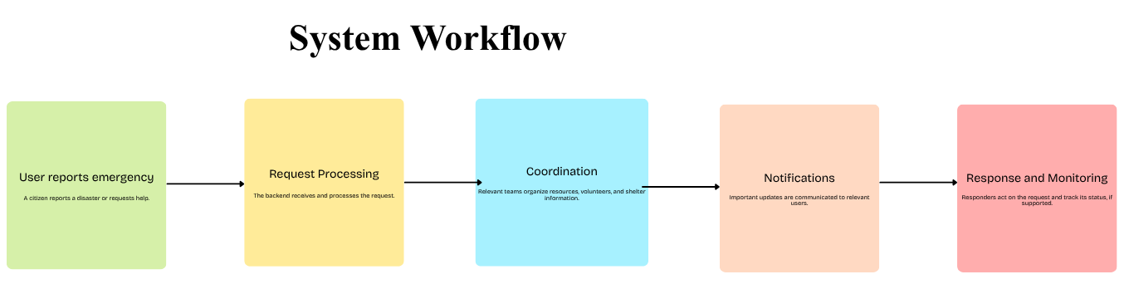
System Workflow

Slide 11
Conclusion and Future Scope
Conclusion
By combining React.js, Spring Boot, PostgreSQL, microservices, Docker, and Kubernetes, the project demonstrates the application of cloud-native concepts to a socially relevant problem.
The system aims to improve coordination, modularity, deployment flexibility, and the ability to adapt to changing demand.
Future Scope
Introduce priority-based emergency request handling.
Add real-time notifications and status tracking.
Integrate external emergency services and relief organizations.
Improve monitoring, security, and automated deployment.
Evaluate performance and scalability under simulated disaster workloads.

Slide 12
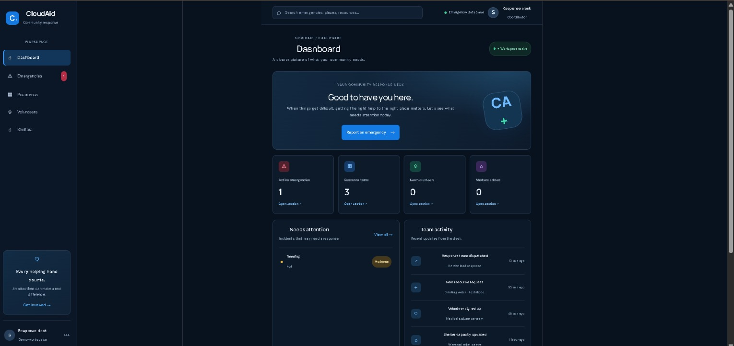
Output

Slide 13
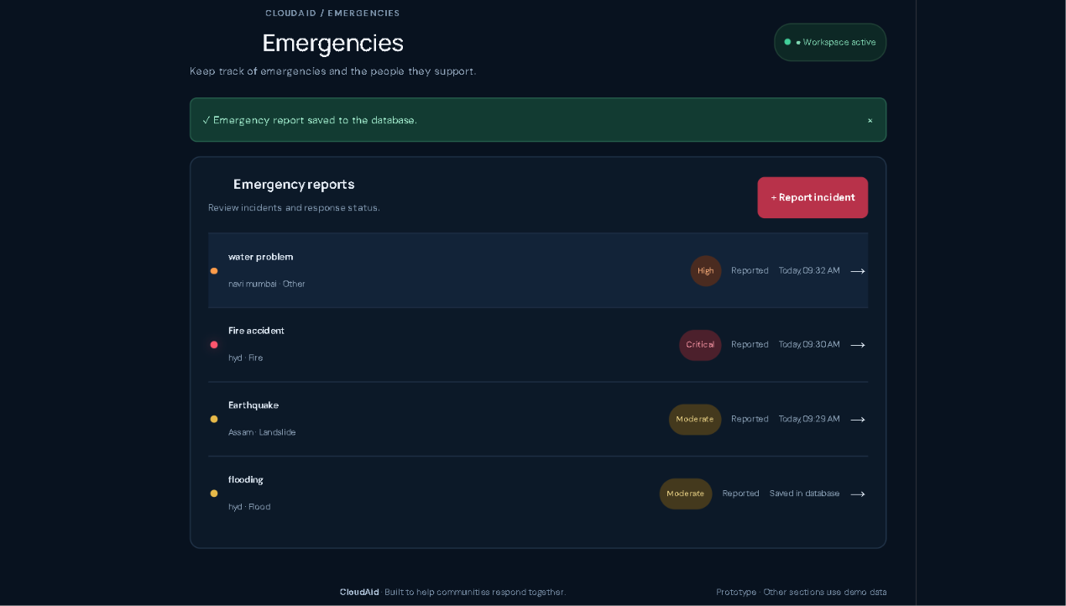
Output

Slide 14
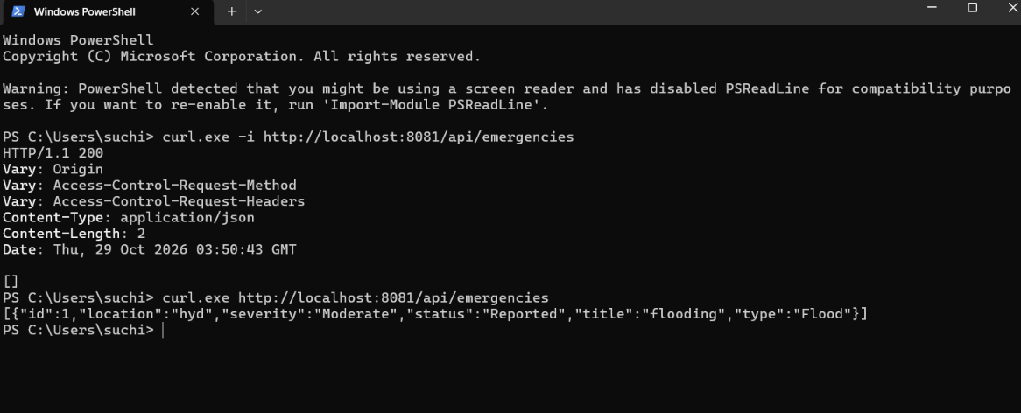
Output

Slide 15
GitHub Repo Link
GitHub Link: https://github.com/Suchita-90122/CNAD-cloudaid-.git

